Slide 1
Introduction to Programming

Slide 2
What is Programming?
Computer – A machine that processes data according to instructions
E.g. PC, smartphone, mainframe, game console, …
Data: user inputs, text, keystrokes, audio, video, etc.
Instructions: programs, apps, etc.
Computer Program – A set of instructions that tells a computer how to process data
Programming – Writing sets of instructions in some languages that tell computers what to do
Notes:
What do all computers have in common?
Answer: Processor, memory, input peripherals, output peripherals, secondary storage.
(Once you master programming skill, you can write programs to run on different computers.)

Slide 3
Programming Languages
Machine Language
11000100101010010100101111101010
Inconveniently, machines only speak their mother tongue, usually in binary codes.
The action is called “Assemble”.
Assembly Language
add eax, ebx
Assembly language is a nicer one. Yet, it is all not human friendly.
The action is called “Compile”.
High-level Programming Language
total = principal + profit * 0.9;
As a human programmer, we usually write in high-level programming languages.

Slide 4
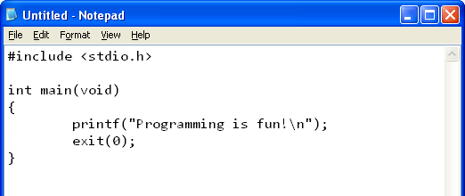
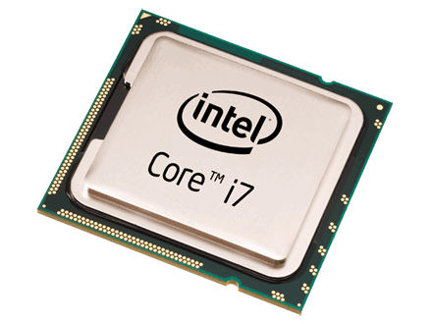
Programming Cycle
Language translation and grammar checking with some software (compilers)
Save as a program code source file, e.g. “hello.c”
Compilation
(Build)
Compile +
Assemble
Compilation FAILED!
Read error and warning messages, modify code to retry.
Use a text editor to write high-level program code
NO! Check results and modify code, i.e., debugging
YES,
Bingo!
Is the result correct?
Generate object code
and save the target in a
machine executable file,
e.g. “MyApp.exe”
Program testing
Execution

Slide 5
Fundamentals of Programming
Understand the basic concepts and principles of programming
Understand and memorize the syntax of a programming language
Turn your idea/solution into equivalent instructions
Know what APIs (Application Programming Interface) are available and learn how to use them
Notes:
Understand the basic concepts and principles of programming
e.g.: variables, data type, functions, parameters, control structures, arrays, class, object, etc.
These concepts and principles are "universal".
Understand and memorize the syntax of a programming language
Different languages have different syntax and grammar.
A program with syntax errors won't execute correctly.
Turn your idea and solution into equivalent instructions
Analogous to learning English/Chinese – in addition to knowing the grammars and vocabularies, you also need to learn how to make sentences and compose essays.
Practices make perfect
Know what APIs (Application Programming Interface) are available and learn how to use them
APIs here refer to collections of "codes" (written by other people) that offer programmers some commonly needed functions.
e.g., print data to screen, send data over network, display a window, etc.
If you can find the appropriate APIs to use in your program, you can potentially save a lot of time from writing everything from scratch.
You can learn how to use an API by studying the API documentation (the manual).

Slide 6
Fundamentals of Programming (Explained)
Understand the basic concepts and principles of programming
e.g.: variables, data type, functions, parameters, control structures, arrays, class, object, etc.
These concepts and principles are "universal".
Understand and memorize the syntax of a programming language
Different languages have different syntax and grammar.
A program with syntax errors won't execute correctly.
Turn your idea and solution into equivalent instructions
Analogous to learning English/Chinese – in addition to knowing the grammars and vocabularies, you also need to learn how to make sentences and compose essays.
Practices make perfect
Know what APIs (Application Programming Interface) are available and learn how to use them
APIs here refer to collections of "codes" (written by other people) that offer programmers some commonly needed functions.
e.g., print data to screen, send data over network, display a window, etc.
If you can find the appropriate APIs to use in your program, you can potentially save a lot of time from writing everything from scratch.

Slide 7
Our Tool -- Code::Blocks
An Integrated Development Environment (IDE)
Project and file management
Code editing
Build (Compile + Link) and Run
Debugging support
Open source and free!

Slide 8
Other Programming Tools
Visual Studio Community
An Integrated Development Environment (IDE)
Editor + Compiler + Debugger + Other development tools
VS Community Edition is free to download
Sign in using CUHK CWEM Microsoft O365 account
More tools from Microsoft
https://www.dreamspark.com/ (Free!)
Sign up with CUHK CWEM email address!

Slide 9
Reading Assignment
C: How to Program, 8th ed, Deitel and Deitel
Chapter 1 Introduction to Computers
Sections 1.1 – 1.5, 1.9

